Slide 1

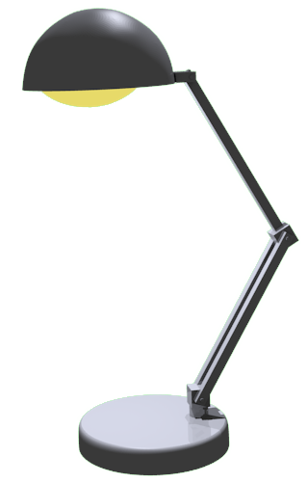

Motus Unitatis,
an Animation Editor
Tim Elmer & Bryan Castillo
Notes:
Or MU, pronounced “Moo” - Moo? Why not pronounced “Mew”? We could use the greek mu symbol then. We could also have version 2 and have a super powerful “Mu(ew) 2”. Hell yes.

Slide 2
Motus Unitatis: Purpose
The Motus Unitatis Animator Editor allows artists and designers to edit and create short animated clips. With MU, a designer has the ability to place objects at different positions with different rotations at different points in time. When the user plays the sequence, MU will create smooth animations between saved key frames. MU supports both a play mode and a simple editing mode. In addition to editing object position and rotation, users have the ability to edit, and delete keyframes.

Slide 3
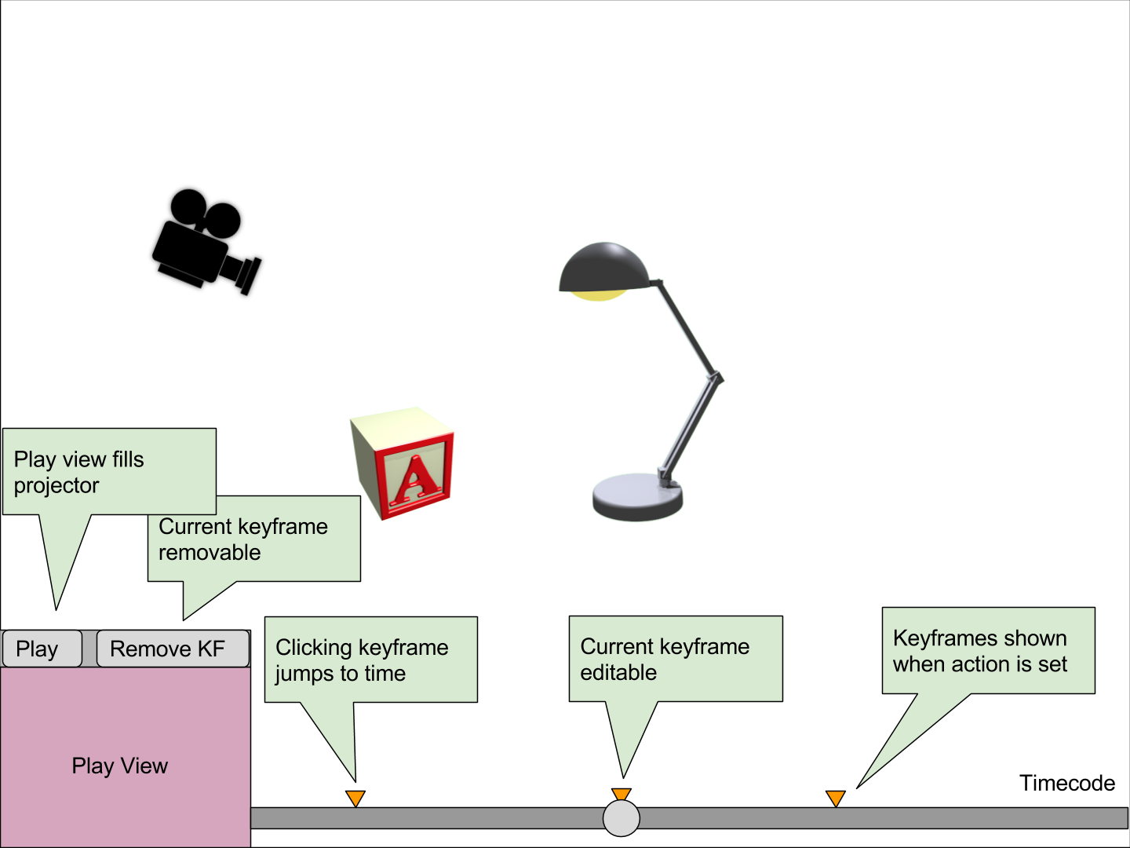
Layout - Edit Mode

Slide 4
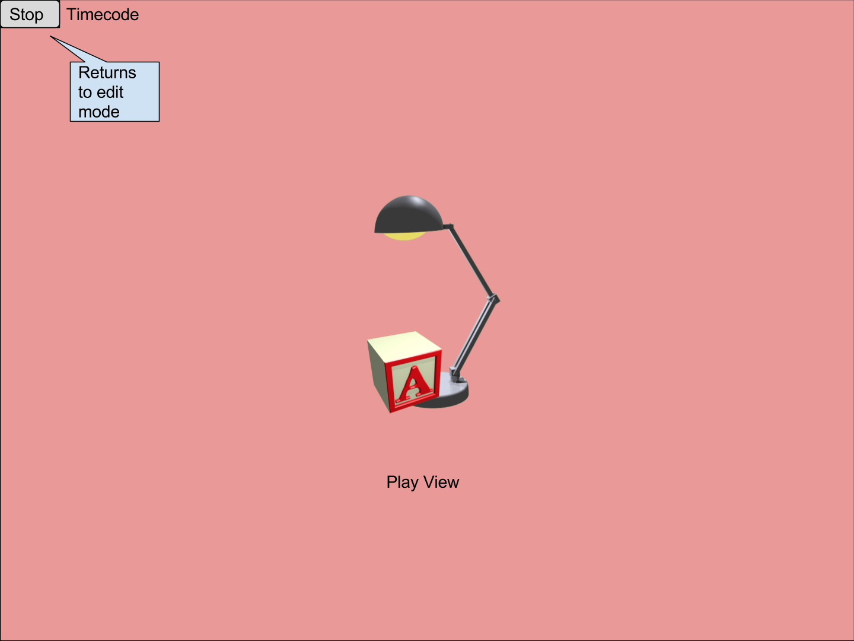
Layout - Play Mode

Slide 5
Technical Requirements
Working with graphical objects
Display a lamp in a SceneNode hierarchy
Allow user to translate hierarchy and rotate members via a 3D manipulator
Interaction of objects
Display other interesting meshes: a letter block and a ball
Detect collision of lamp head with meshes and react
Illumination and texture
Parent a light source to the lamp head
Support illumination on lamp members
Display a texture on lamp members

Slide 6
Technical Requirements - Cont.
Two different views and camera manipulation
Display “play mode camera” viewport in “edit mode”
Allow manipulation of “play mode camera” via a 3D manipulator
Allow manipulation of “edit mode camera” via mouse controls

Slide 7
Project Plan
Milestone | Sprint | Sprint Week | Status
Project Proposal | 1 | 11/7 to 11/13 | Complete
Requirements Specification | 1 | 11/7 to 11/13 | Complete
Base Project Structure | 1 | 11/7 to 11/13 | Complete
Base Objects | 2 | 11/14 to 11/20 | Not Started
Edit Mode Skeleton | 2 | 11/14 to 11/20 | In Progress
Play Mode Skeleton | 2 | 11/14 to 11/20 | In Progress
Mode Switching | 2 | 11/14 to 11/20 | In Progress
Key Frame Object Model | 3 | 11/21 to 11/27 | Not Started
Time Line UI | 3 | 11/21 to 11/27 | Not Started
Object Edit Creates Key Frame | 3 | 11/21 to 11/27 | Not Started
Play Mode Animation | 4 | 11/28 to 12/4 | Not Started
Edit Mode Mouse Manipulation | 4 | 11/28 to 12/4 | Not Started
Delete Key Frame | 5 | 12/4 to 12/11 | Not Started
Play Camera Display in Edit | 5 | 12/4 to 12/11 | Not Started
Release Testing | 5 | 12/4 to 12/11 | Not Started

